Slide 1
Phonetics of English: An Introduction
Understanding the Sounds of English

Slide 2
Pronounce these words
Cat Keen Occasion
Chemistry Chemist Character
Chest Cheese Enough
Rough City
Machine Attach

Slide 3
Pronounce these words
Silent Sounds
Mine Listen Psychology
Hour

Slide 4
What is Phonetics?
Phonetics is the branch of linguistics that deals with the sounds of speech and their production, combination, description, and representation by symbols.

Slide 5
What is Standard English Pronunciation?
Standard English pronunciation refers to the widely accepted way of pronouncing words in English, often considered the norm for formal communication, education, and media.
There are two main standards:
Received Pronunciation (RP): Also known as the “Queen's English,” RP is the standard pronunciation of England, often used by the BBC and in formal situations.
General American: This is the standard pronunciation used in the United States, often considered neutral and widely understood.
Standard English pronunciation typically involves:
-Clear articulation of vowels and consonants
- Correct stress patterns and intonation
- Neutral accent, avoiding regional or cultural biases
Standard symbols are called- International Phonetic Alphabet ( IPA for short)
To depict the correct pronunciation in dictionaries, the use of a standard symbol for standard sound, i.e. transcription, is given.

Slide 6
Why should you know about the sounds of English?
To improve your pronunciation
To make your communication effective and impressive
To build your soulful image

Slide 7
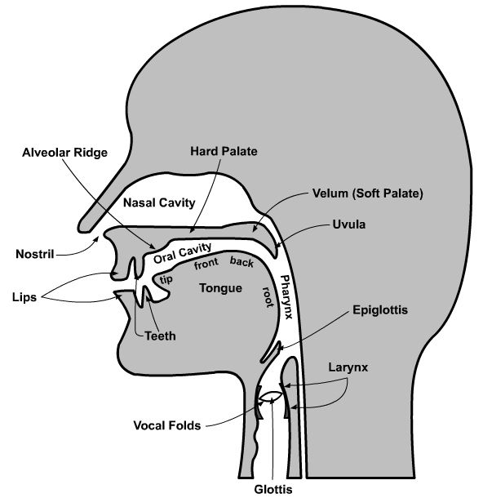
Human Vocal Tract

Slide 8
Classification of sounds
Oral and nasal: Sounds produced with the help of human speech organs by forcing the air stream out of the lungs either through the mouth or the nose.
Oral sounds: Air is released through the mouth
Nasal sounds: Air is released either fully or partially through the nose
Voiced: Sounds produced by vibration of vocal cords.
For example vowels, diphthongs (combination of two vowel sounds or two vowel letters), and consonants such as /b/, /d/, and /m/.
Unvoiced sounds: Vocal cords do not vibrate and air passes through the wide-open glottis.

Slide 9
Classification of sounds
Vowels: All vowels are oral and voiced. (a, e, i, o, u)
Consonants: Only three are nasal ( /m/, /n/, and /ᵑ/ ( as in sing), several oral consonants are unvoiced)
Consonants are distinguished from vowels by their manner of production.

Slide 10
Vowels in English
Twenty vowel sounds in English.
These twenty vowel sounds are further classified as pure vowel sounds (12) and diphthongs (8).
Pure Vowel sound: Its quality does not change during production.

Slide 11
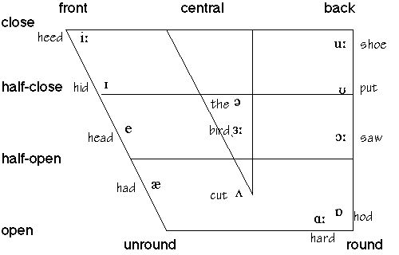
Vowel Chart: Tongue Position and Lip

Slide 12
Vowels in English
Vowel Sound | Example Words
/i:/ ई | Me, these, need, be, keep, deep, sheep, Jeep, beep, eat, feel, see, meet, deal, read, beat, peak, seek, heap, leap, feet, seat, heel, keen, seen, teen, leave
/ɪ/ | इ | With, this, if, think, link, wink, rink, sink, big, six, live, since, miss, wrist, lift, pit, sit, pick, bill, fill, till, him, pin, tin, win, bid, did
/ʊ/ उ | Put, Would, Look, Woman, Hook, Nook, Food, Fool, Cool, Hue, Ooze, Moose, Boot, Cook, Rook, Took, Good
/u:/ ऊ | To, You, New, Who

Slide 13
Vowels in English
/e/ ए Get, When, Well, Very, Bed, Said, Leg, Hell, Hem, Ben, Pen, Den, Ten, Men, Bend, Lend, Send, Bet, Met, Pet, Set, Mess, Wreck, Peck, Letter, Better
/ə/ The, About, Could, Us
/ɜ:/ Her, Work, Learn, Word, Burn, Turn, Firm, Bird, Curd, Curse, Curt, Shirt, Turk, Curl, Hurl, Earl, Pearl, Sir, Worm, worth, Fir, Stir, Sir, Occur, Purr
/ɔ:/ ओो Or, Also, More, Call, All, Mall, Hall, Fall, Tall, Wall, Paul, War, Ward, Warm, Reward, Walk, Wart

Slide 14
Vowels in English
/æ/ ऐ | Have, That, As, Can, Sad, bad, Bag, Lag, Hal, Ham, Ban, Pan, Dan, Tan, Man, Band, Land, Sand, Bat, Mat, Pat, Sat, Mass, Rack, Pack, Latter, Batter
/ʌ/ अ | But, Up, One, Much
/ɑ:/ आ | Start, Ask, Large, After
/ɒ/ ओ | Of, On, From, Not

Slide 15
Diphthongs in English
In the production of a diphthong, one sound position glides to another.
/aɪ/
Cry /kraɪ/
My /maɪ/
Like /laɪk/
Bright /braɪt/
Lime /laɪm/

Slide 16
Diphthongs in English
/eɪ/
Bake /b eɪk/
Rain /r eɪn/
Lay /l eɪ/
Eight / eɪt/
Break /br eɪk/

Slide 17
Diphthongs in English
/əʊ/
Go /g əʊ/
Oh / əʊ/
Slow /sl əʊ/
Loan /l əʊn/

Slide 18
Diphthongs in English
/aʊ/
Bound /b aʊnd/
House /h aʊs/
Brown /br aʊn/
How /h aʊ/
Now /n aʊ/

Slide 19
Diphthongs in English
/eə/
Pair /p eə/
Lair /l eə/
Stare /st eər/
Care /k eər/
Bear /b eə/

Slide 20
Diphthongs in English
/ɪə/
1. Career /kəˈrɪə/
2. Here /hɪə/
3. Near /nɪə/
4. Year /jɪə/
5. Pier /pɪə/

Slide 21
Diphthongs in English
/ɔɪ/
Boy /b ɔɪ/
Coy /k ɔɪ/
Toy /t ɔɪ/
Foil /f ɔɪl/
Coin /k ɔɪn/

Slide 22
Diphthongs in English
/ʊə/
1. Sure /ʃʊə/
2. Lure /lʊə/
3. Pure /pjʊə/
4. Manure /mənʊə/ or /mænjʊə/

Slide 23
Consonants in English
Consonants
There are 24 consonant sounds in most English accents, conveyed by 21 letters of the regular English alphabet (sometimes in combination, e.g., ch and th).
THE CONSONANTS OF ENGLISH

Slide 24
Consonants in English
/s/ (स) saw /s ɔ:/ house /haʊs/
/z/ zap /z æ p/ goes /g əʊ z/
/ʃ/ (श) shape / ʃ eɪ / push /p ʊ ʃ/
/ʒ/ pleasure/ ˈplɛʒə/ beige /beɪʒ/
/h/ (ह) her /h ɜ: / ahead/əhed/
/x/ loch/lɒx/

Slide 25
Consonants in English
/tʃ/ - cherry /ˈtʃeri/ - match /mætʃ
/ʤ/ - judge /ʤʌʤ/ - raj /raːʤ/.
/m/ - man /mæn/ - team /tiːm/
/n/ - nail /neɪl/ - tan /tæn
/ŋ/ - ring /rɪŋ/ - singer /ˈsɪŋər/
/l/ - let /let/ - tall /tɔːl/
/r/ - right /raɪt/ - scary /ˈskɛri/ or /ˈskɛəri/
/w/ - wet /wet/ - away /əˈweɪ/
/j/ - you /juː/

Slide 26
Consonants in English
Sound Examples
/p/ (प) pair, cup
/b/ (ब) bad, crab
/t/ (ट) tall, hit
/d/ (ड ) dark, head
/k/ (क ) cab, lack
/g/ (ग ) good, tag
/f/ (फ) fine, wife
/v/ (व) very, above
/θ/ (थ ) thing, both
/ð/ (द) this, father

Slide 27
Problems of Indian English
/z/
Eyes
Falls
Fears
His
Knees
/s/
Ice
False
Fierce
Hiss
Niece

Slide 28
Problems of Indian English
/ʃ/
/s/
Shave
She
Sheet
shine
Save
See
Seat
Sign

Slide 29
Problems of Indian English
/w/
While
West
Why
/v/
Vile
Vest
Vie

Slide 30
Place of Articulation:
Bilabial: Both lips are used to create the sound (e.g., /p/, /b/, /m/).
Labiodental: The lower lip and upper teeth are used (e.g., /f/, /v/).
Dental: The tongue tip or blade makes contact with the upper teeth (e.g., /θ/, /ð/).
Alveolar: The tongue tip or blade makes contact with the alveolar ridge (the gum ridge behind your upper teeth) (e.g., /t/, /d/, /s/, /z/, /n/, /l/).
Post-alveolar: The tongue is retracted slightly from the alveolar ridge (e.g., /r/).
Palatal: The front of the tongue is raised towards the hard palate (the roof of the mouth) (e.g., /j/).
Velar: The back of the tongue makes contact with the soft palate (velum) (e.g., /k/, /g/, /ŋ/).
Glottal: The sound is produced at the glottis (e.g., /h/).

Slide 31
Manner of Articulation:
Stops (Plosives): Complete closure of the vocal tract, then a release of air (e.g., /p/, /b/, /t/, /d/, /k/, /g/).
Fricatives: Close approximation of articulators, creating a turbulent airflow (e.g., /f/, /v/, /θ/, /ð/, /s/, /z/, /ʃ/, /ʒ/, /h/).
Affricates: A combination of a stop and a fricative (e.g., /tʃ/, /dʒ/).
Nasals: Airflow through the nasal cavity (e.g., /m/, /n/, /ŋ/).
Approximants: Articulators come close together, but not close enough to create significant turbulence (e.g., /w/, /j/, /l/, /r/).
Flaps/Trills: Rapid, brief contacts between the tongue and another articulator.

Slide 32
Practice Tongue Twisters
She sells sea shells on the seashore.
Peter Piper Picked a Peck of Pickled Peppers.

